Slide 1






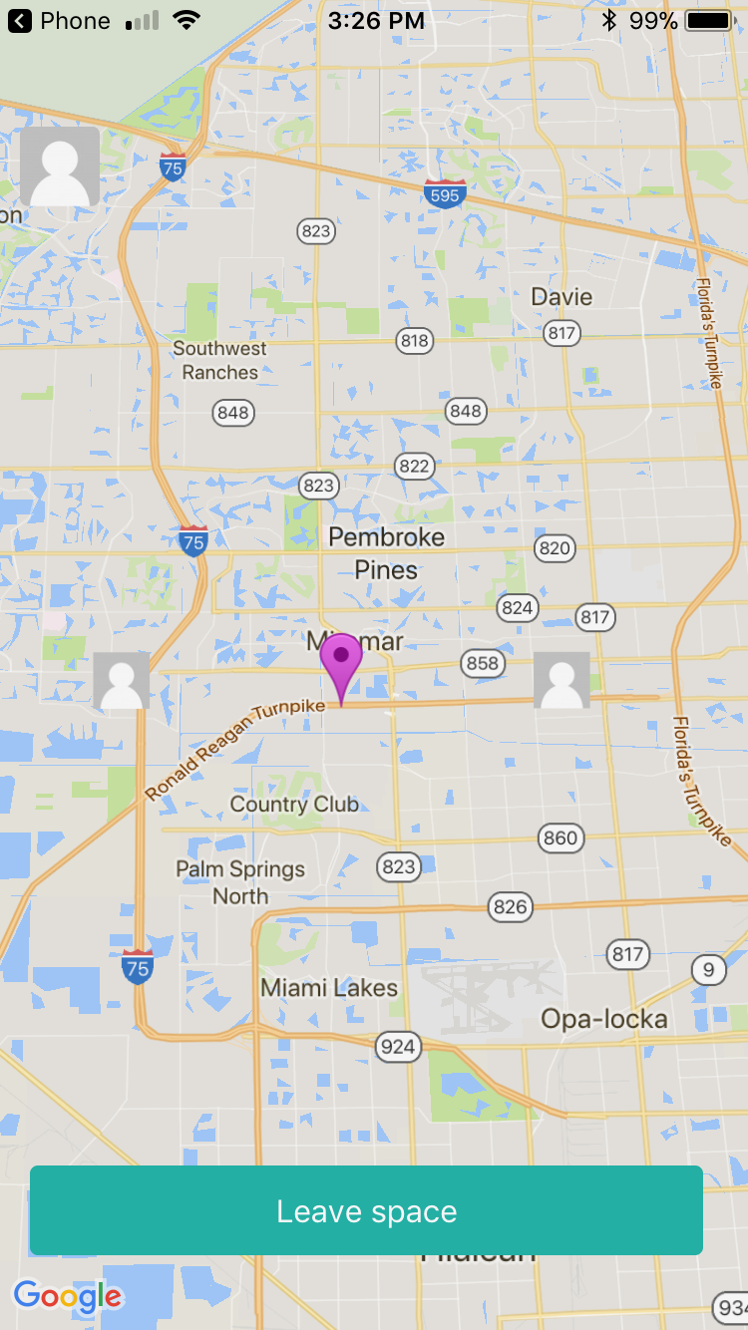
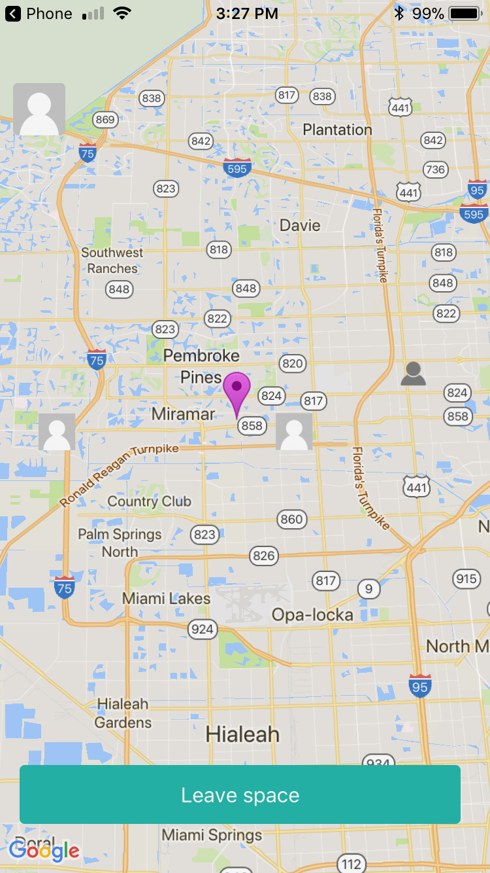
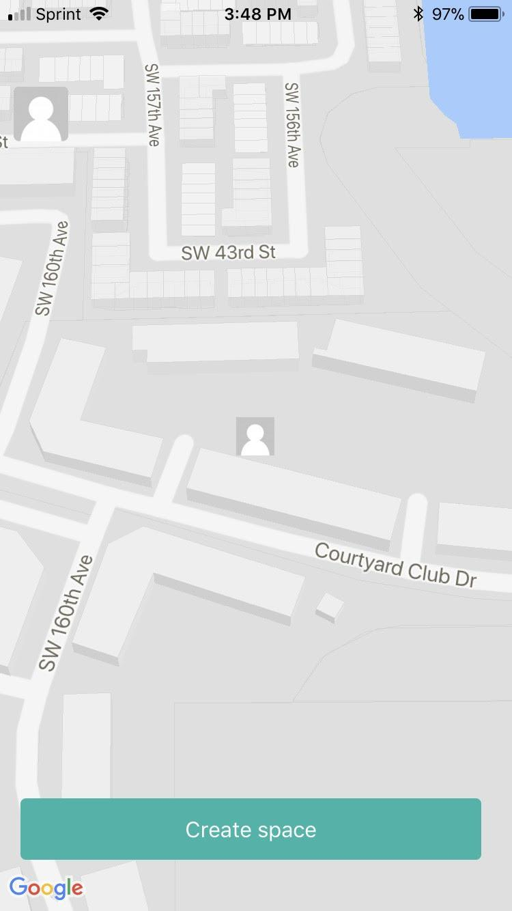
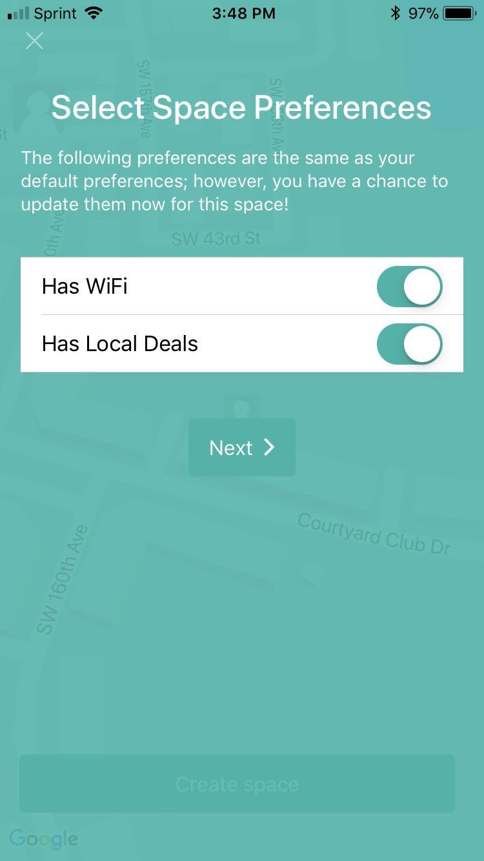
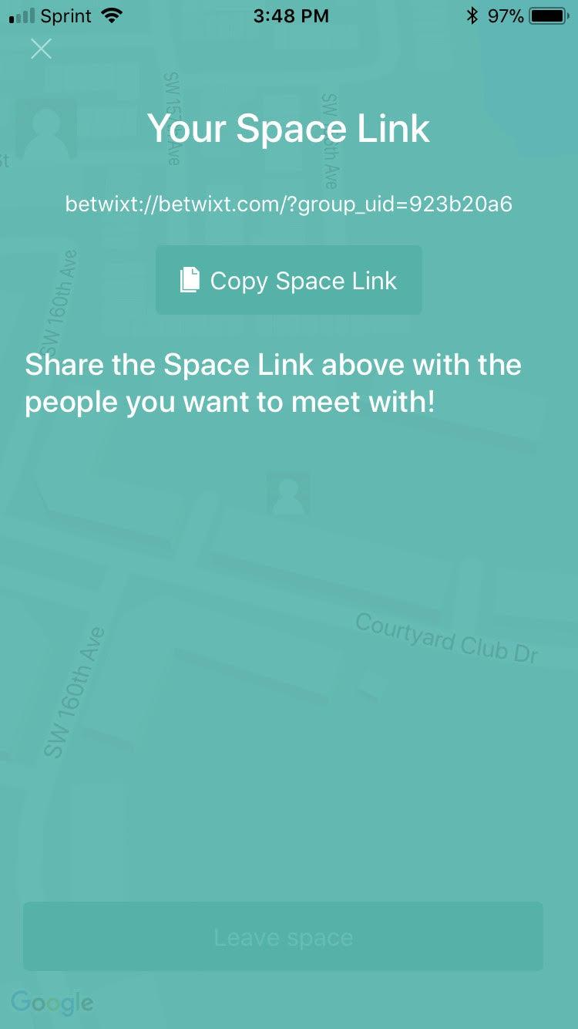
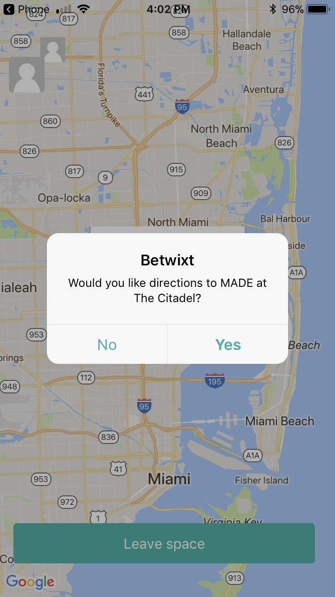
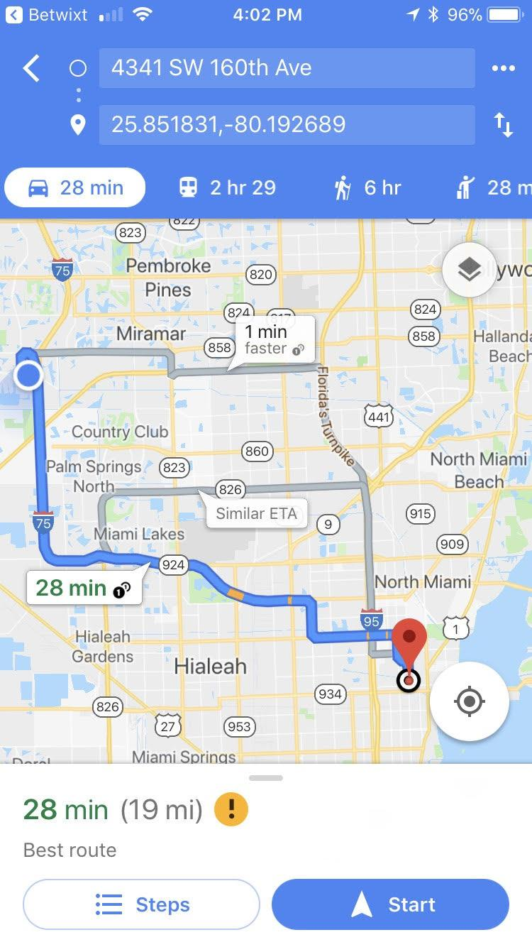


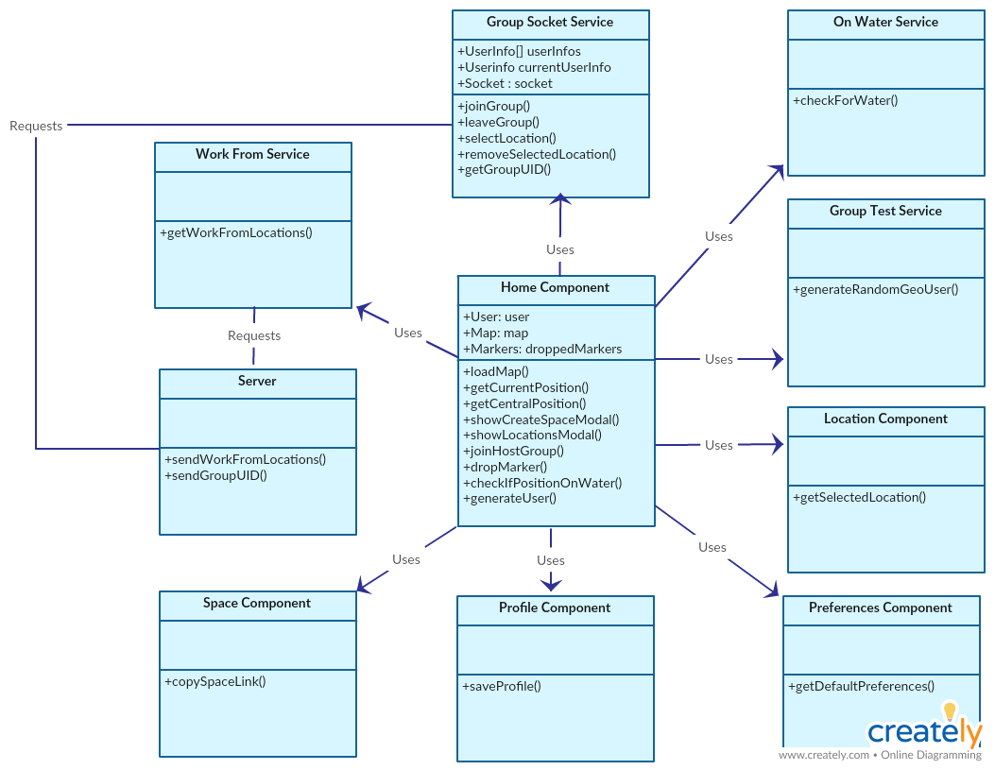
School of Computing & Information Sciences
Senior Project, 2017, Fall
Betwixt 1.0
Student: Alejandro Palacios, Florida International University
Mentor: Joseph Cutrono, Ultimate Software
Instructor: Masoud Sadjadi, Florida International University
Problem
Virtual Employees (VE) need a place to meet up.
No place to meet up in office space.
Need a public space that is mutually convenient for them.
Solution
App Allows VEs to join a Space.
Central location is calculated between them.
Space host chooses a public space close to the central location.
Current System
iOS and Android Mobile App.
Create a Space and send link to VEs.
Central location is calculated.
Able to choose a public space around the central location.
Images
Adjusting the central location
Creating a Space
Redirecting to navigation app
When a user joins or leaves, the central location pin is adjusted accordingly.
When creating a space, you are asked for your preferences via a modal. You can then send the link to other VEs which will redirect them to the app and drop a pin at their location.
Clicking on the selected location for the Space will ask if you would like directions to the location. This will open up Google Maps if installed. If not, it will allow you to select a navigation app.
Requirements
Must run on iOS and Android.
Create and join a Space.
Calculate a central location between VEs
Central location must be dynamic.
Communication pipeline between all users (sockets).
Use link to join group and open app on click.
System Design
Implementation
Ionic Framework and Angularjs for front-end mobile app dev.
Node Js backend and Express Framework for back-end.
Google Maps API for map view.
Socket.IO for communication between clients.
Work From API for getting locations by central location.
Verification
Testing done on both iOS and Android. Both emulators and phones were used.
Button on front-end for developers to generate users in a Space within a 10 mile radius of your location.
Postman used to test HTTPS requests on the server.
Object Design
Summary
App is functional and solves the problem.
Able to join a Space via. a link which opens the app.
Central location adjusts when a user joins or leaves.
Clicking on the selected location redirects user to a navigation app.
Acknowledgements
The material presented in this poster is based upon the work supported by Joseph Cutrono.
I am extremely thankful to our excellent Product Owner and my team members Alicia Rodriguez and Daniel Raad.
Notes:
Problem – Solution – Current System
Images
Requirements – System Design – Implementation
Verification – Object Design – Summary
‹#›

